Slide 1
Oral Cancer Detection using Deep Learning
Md. Imtiaz Hoque
Md. Azmi Siddique
Md. Jahirul Islam
1811330042
1812307042
1821368642

Slide 2
List of Contents
Abstract
Description of our project
Why we choose this project?
Methodology
Dataset description
Deep learning model
Results
Limitations
Conclusion

Slide 3
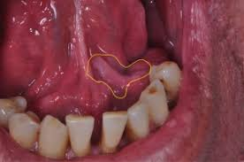
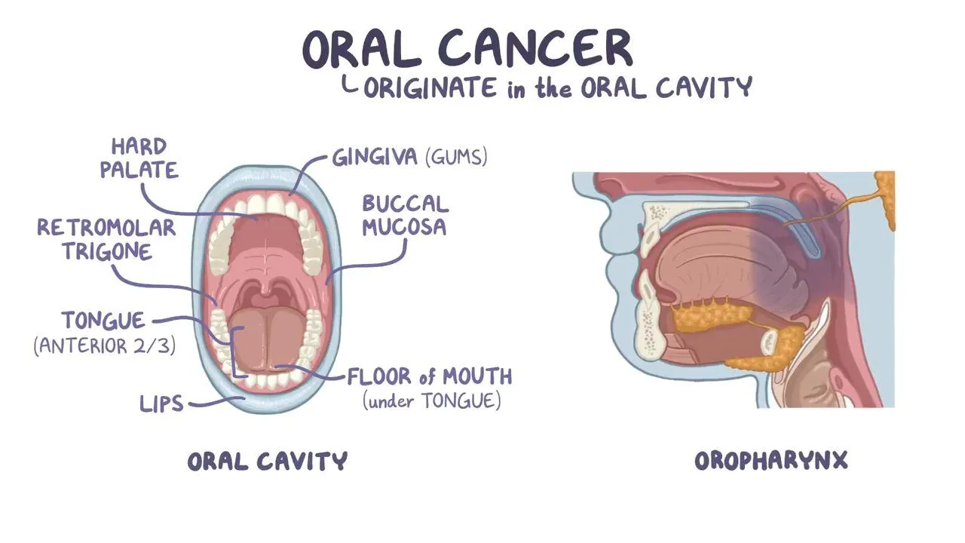
Abstract
Oral cancer is a tumor that develops in a part of the mouth. It may be on the surface of the tongue, the inside of the cheeks, the roof of the mouth (palate), the lips or gums. It is difficult, widespread cancer with a high fatality rate.
Deep learning is a machine learning and artificial intelligence (AI) technique inspired by human learning. Data science, which covers statistics and predictive modeling, contains deep learning as a major component.
We have applied CNN , Custom CNN, ResNet50, ANN model which includes deep pooling, Flatten, Dense, conv2d, maxpool, dropout and multiple layers. For performance analysis we used f1 score, choen kappa score and confusion matrix.

Slide 4
Description of our project
Our project is a system that detect oral cancer with histopathologic image dataset trained with deep learning methods. As oral cancer have high death ration worldwide so early detection can give time for treatment. And make the system affordable.

Slide 5
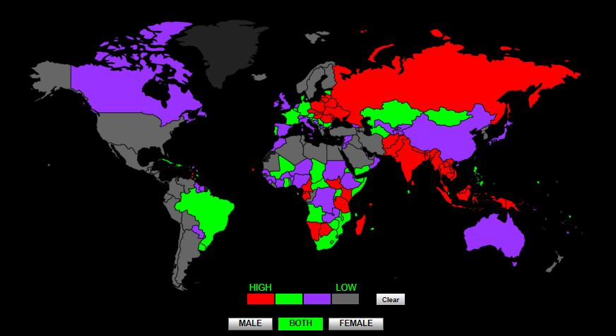
Why we choose this project?
Oral cancer at early stage if can be detected than the survival chance gets high. Oral cancer being one of the deadliest cancer is costly to detect and if diagnosed then the expense for treatment is high too. In those countries where betel leaf, tobacco is common has high risk of oral cancer and due to high cost detection test and treatment becomes unaffordable for a large number of people.
SL No. | Country | Ratio
1 | KIRIBATI | 13.84
2 | NEW GUINEA | 12.56
3 | SEYCHELLES | 12.25
4 | BANGLADESH | 12.13
5 | PAKISTAN | 11.65
6 | INDIA | 11.45
7 | SRI LANKA | 10.87
8 | MYANMAR | 8.77
9 | AFGHANISTAN | 8.18
10 | SLOVAKIA | 7.93
As we can see that Asia is on high risk.
Death rate of Bangladesh is 12.13% which is forth in place worldwide.

Slide 6
Methodology
We use deep learning methods approach to solve this problem by implemented multiple models.
CNN
Custom CNN
ResNet50
ANN(Artificial Neural Network)
First we process the data with image data generator named ImageDataGenerator. By passing an integer number in the rotation range parameter, randomly rotated pictures by any degree between 0 and 360.
Then we pass the processed the data on our model and trained it.

Slide 7
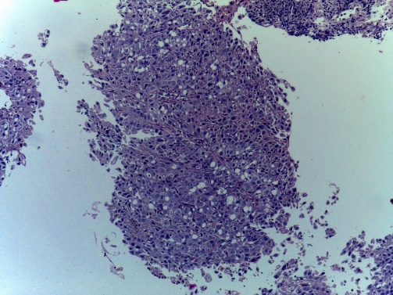
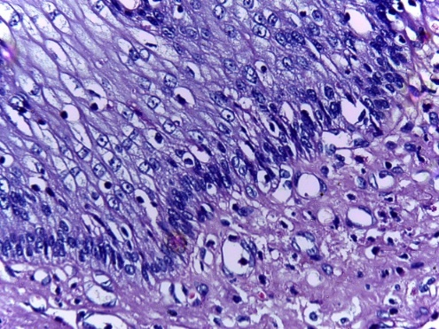
Dataset Description
To develop this system we have collected data from kaggle. We choose Histopathologic image dataset which is around 3GB.
Histopathology is the study of disease symptoms through microscopic inspection of a biopsy or surgical specimen that has been processed and put onto glass slides.
The dataset contains two classes:
1. Normal
2. OSCC(Oral squamous cell carcinoma)
This System’s dataset contains 5192 Histopathologic images. 2494 of Normal Histopathologic images and 2698 images of oral cancer effected Histopathologic images were used on this system.
Data were spitted in three sections 70% for training, 20% for validation and 10% for testing.
Oral cancer effected histopathologic image
Normal histopathologic image

Slide 8
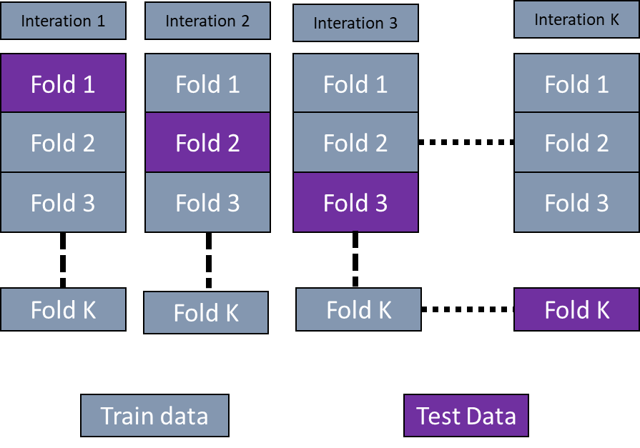
Deep Learning Model
K- fold cross-validation

Slide 9
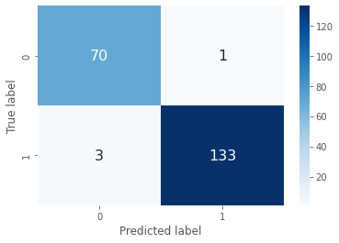
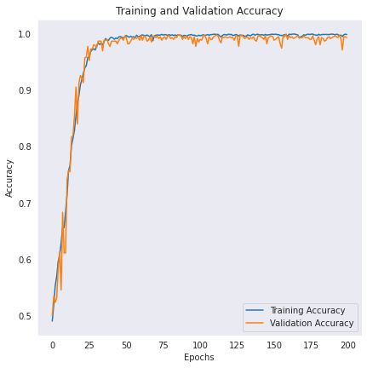
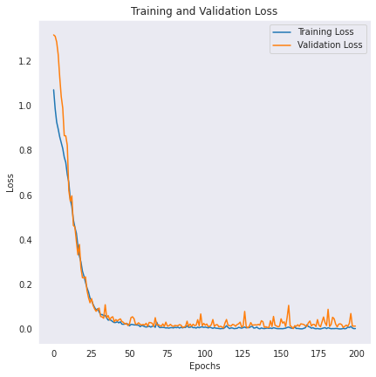
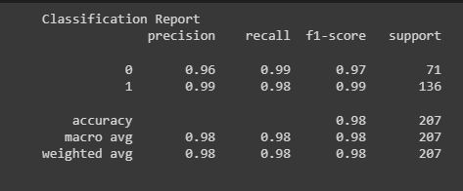

Results
We implemented multiple models but the best outcome was form Custom CNN. As Custom CNN algorithm which can effective on small number of dataset but normal CNN model needs larger ones.
Algorithm | Accuracy (%)
Custom CNN | 99.33
ANN | 86.9
ResNet50 | 80.0
CNN | 89.2

Slide 10
Limitations
Dataset is publically available but smaller in size.
To run the model we need better GPU.
Google colab is free but have limited time uses. It run 90 minutes if close the browser and 12 hours if keep the browser open.
Google colab has storage limitations.
internet dependent.

Slide 11
Conclusion
Early detection of oral cancer.
We have massive dataset that we can segment and train effectively.
After successful development, it will produce findings with an accuracy of 99.33 percent.

